Slide 1
We are good at rating our own experiences
In this experiment, you will rate your experience for a series of tasks

Slide 2
Here are the three tasks you will experience and rate!
non-pain mental rotation
your own pain
other people’s pain
Notes:
Here are the three: mental rotation task, thermal pain task, and vicarious pain task

Slide 3
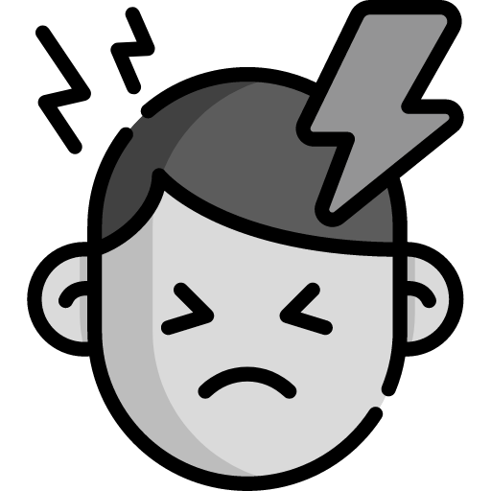


non-pain mental rotation
your own pain
other people’s pain
Notes:
For The mental rotation task, you will look at two figures and decide whether they are the same of not.

Slide 4
non-pain mental rotation
your own pain
other people’s pain
You will look at two figures and decide
whether they are the “same” or “different”
and rate how difficult it was

Slide 5
non-pain mental rotation
your own pain
other people’s pain
You will look at two figures and decide
whether they are the “same” or “different”
and rate how difficult it was

Slide 6
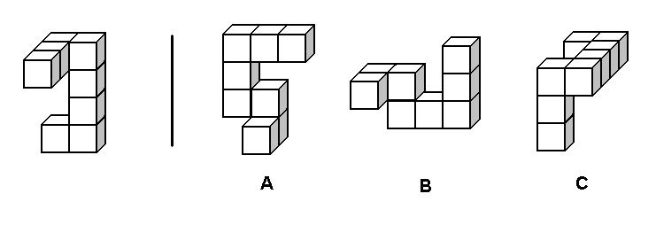
non-pain mental rotation
your own pain
other people’s pain
Notes:
For the thermal pain task, you will experience painful but non-damaging thermal stimulus

Slide 7
non-pain mental rotation
your own pain
other people’s pain
You’ll experience painful but non-damaging thermal stimulus
on your leg and rate how painful it was

Slide 8
non-pain mental rotation
your own pain
other people’s pain
You’ll experience painful but non-damaging thermal stimulus
on your leg and rate how painful it was

Slide 9
non-pain mental rotation
your own pain
other people’s pain
You’ll experience painful but non-damaging thermal stimulus
on your leg and rate how painful it was
+ please indicate the “peak” of the heat stimulus

Slide 10
non-pain mental rotation
your own pain
other people’s pain
Notes:
Lastly, for the vicarious pain task, you will look at videos of people with back should pain. These are real patients and we have actual data of their own pain ratings. You job is to look at the videos and estimate how much pain you think they are in.

Slide 11
non-pain mental rotation
your own pain
other people’s pain
You’ll look at videos of people with back shoulder pain
You’ll rate how much pain you think the person is in

Slide 12
non-pain mental rotation
your own pain
other people’s pain
You’ll look at videos of people with back shoulder pain
You’ll rate how much pain you think the person is in

Slide 13
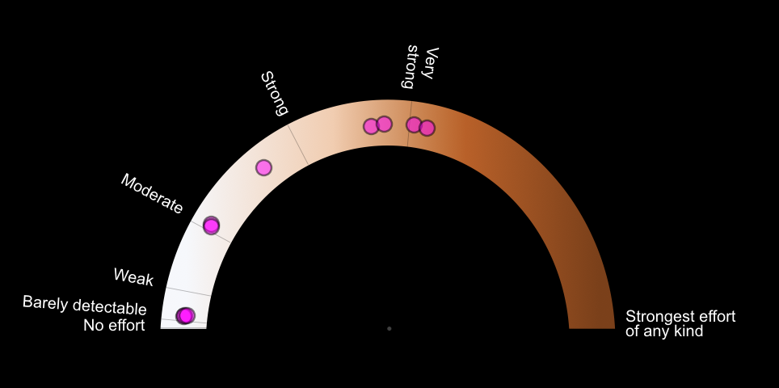
This is the social cue image
Notes:
Prior to each task, you will see ratings from a group of individuals. It is known that social group information is informative and leads to optimal estimation compared to a standalone individual judgment.

Slide 14
The circles are data points from previous participants
On how they’ve rated each stimulus.
Notes:
We will show you datapoints from 10 previous participants

Slide 15
This can give you an idea of what to expect for the upcoming stimulus
Notes:
This can give you an idea of what to expect for the upcoming stimulus

Slide 16
expect
Notes:
When you see the cue “expect”, Please rate your expectations of the task that you are about to perform

Slide 17
expect
When you see the cue “expect”,
Please rate your expectations of the task
that you are about to perform

Slide 18
expect
When you see the cue “expect”,
Please rate your expectations of the task
that you are about to perform

Slide 19
expect
When you see the cue “expect”,
Please rate your expectations of the task
that you are about to perform
+ make sure to respond within 4 sec

Slide 20
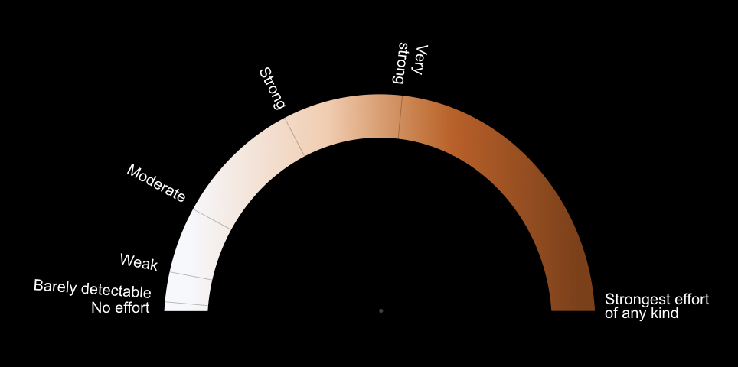
actual
Notes:
When you see the cue “actual”, please rate your actual experience of the task that you’ve just performed. For example, rate how painful the thermal task was. Rate how difficult the mental rotation task was. And lastly, for the vicarious video task, rate how much pain you think the person in the video was.

Slide 21
actual
When you see the cue “actual”,
Please rate your actual experience of the task
that you’ve just completed

Slide 22
actual
When you see the cue “actual”,
Please rate your actual experience of the task
that you’ve just completed

Slide 23
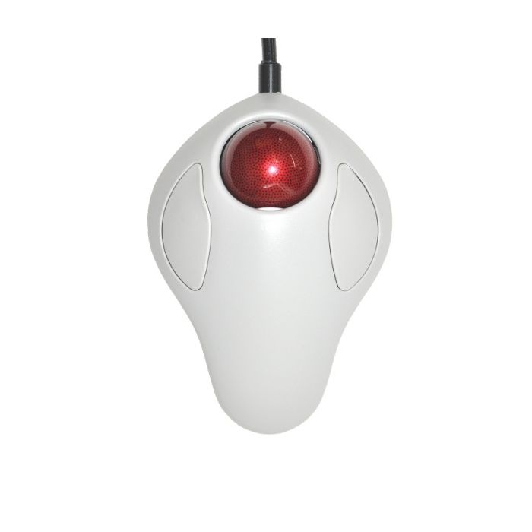
This is the trackball you would use in the scanner
Notes:
Just to get you familiar with the equipment you’ll use during the scanner, here’s an image of the trackball you’d use in the scanner.

Slide 24
expect
Roll the red ball to move the mouse cursor
Notes:
You would roll the red ball to move the cursor along the semi-circle to [CLICK] rate the intensity of each task.

Slide 25
expect
Roll the red ball to move the mouse cursor
and click on the left button to finalize the position
Notes:
You would roll the red ball to move the cursor along the semi-circle to rate the intensity of each task.

Slide 26
expect
Roll the red ball to move the mouse cursor
and click on the left button to finalize the position
the cursor will turn pink after clicking on the left
Notes:
To finalize your rating, you would have to click on the left button. Once you do that, you'll see that the cursor on the screen turns pink. That will be a confirmation that your response is logged in.

Slide 27
diff same
When performing the mental rotation task,
click on the left and right buttons
to respond “diff” or “same”
Notes:
As for the mental rotation task, you're going to be a bit busy, because you'll have to use the two buttons to respond "same or different". Immediately afterwards, you'll be asked to rate the intensity, aka difficulty of this task. So you'll be using the buttons, the trackball, and the buttons again.

Slide 28
1. Cue (other’s ratings)
2. Rate expectations
expect
3. Perform tasks
diff same
4. Rate actual experience
actual
Notes:
This is a summarization of all of the steps of the task. Please let me know if you have any questions.

